Slide 1
Module 5: CPU Scheduling
Basic Concepts
Scheduling Criteria
Scheduling Algorithms
Multiple-Processor Scheduling
Real-Time Scheduling
Algorithm Evaluation

Slide 2
Basic Concepts
Maximum CPU utilization obtained with multiprogramming
CPU–I/O Burst Cycle – Process execution consists of a cycle of CPU execution and I/O wait.
CPU burst distribution

Slide 3
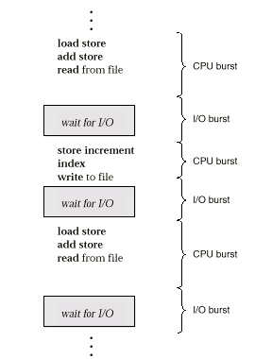
Alternating Sequence of CPU And I/O Bursts

Slide 4
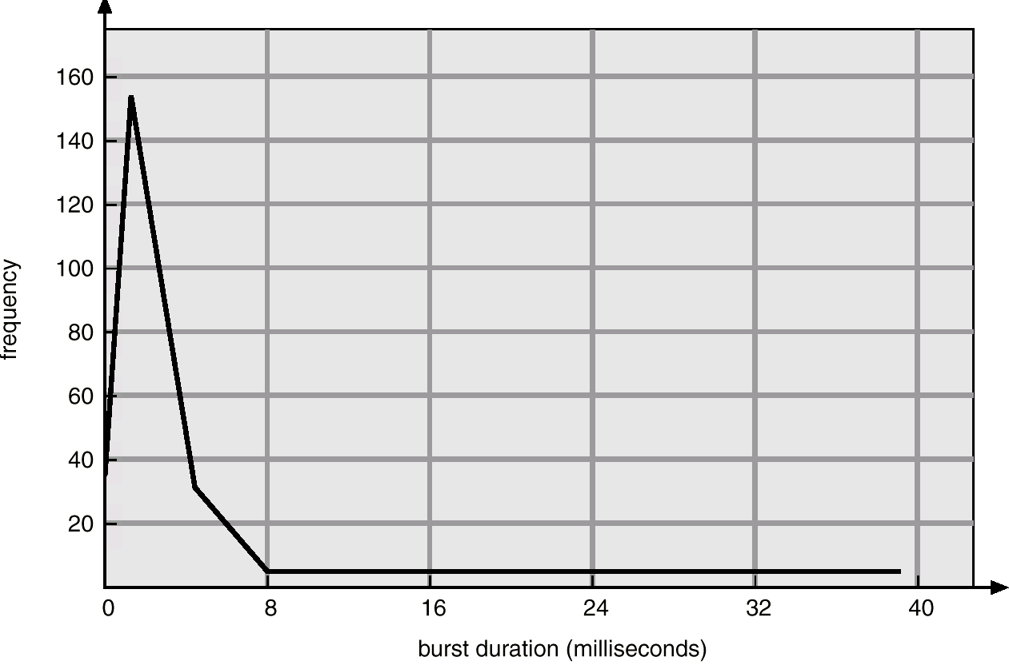
Histogram of CPU-burst Times

Slide 5
CPU Scheduler
Selects from among the processes in memory that are ready to execute, and allocates the CPU to one of them.
CPU scheduling decisions may take place when a process:
  1. Switches from running to waiting state.
  2. Switches from running to ready state.
  3. Switches from waiting to ready.
  4. Terminates.
Scheduling under 1 and 4 is non-preemptive.
All other scheduling is preemptive.

Slide 6
Dispatcher
Dispatcher module gives control of the CPU to the process selected by the short-term scheduler; this involves:
  switching context
  switching to user mode
  jumping to the proper location in the user program to restart that program
Dispatch latency – time it takes for the dispatcher to stop one process and start another running.

Slide 7
CPU scheduling
CPU scheduling is a process which allows one process to use the CPU while the execution of another process is on hold(in waiting state) due to unavailability of any resource like I/O etc,.
The aim of CPU scheduling is to make the system efficient, fast and fair.
First-Come, First-Served (FCFS) Scheduling
Shortest-Job-Next (SJN) Scheduling
Priority Scheduling
Shortest Remaining Time
Round Robin(RR) Scheduling
Multiple-Level Queues Scheduling

Slide 8
Non-preemptive or preemptive
Non-preemptive algorithms are designed so that once a process enters the running state, it cannot be preempted until it completes its allotted time.
Preemptive scheduling is based on priority where a scheduler may preempt a low priority running process anytime when a high priority process enters into a ready state.

Slide 9
Scheduling Criteria
CPU utilization – keep the CPU as busy as possible
Throughput – # of processes that complete their execution per time unit
Turnaround time – amount of time to execute a particular process
Waiting time – amount of time a process has been waiting in the ready queue
Response time – amount of time it takes from when a request was submitted until the first response is produced, not output (for time-sharing environment)

Slide 10
Optimization Criteria
Max CPU utilization
Max throughput
Min turnaround time
Min waiting time
Min response time

Slide 11
First-Come, First-Served (FCFS) Scheduling
Example: Process Burst Time
P₁ 24
P₂ 3
P₃ 3
Suppose that the processes arrive in the order: P₁ , P₂ , P₃
The Gantt Chart for the schedule is:
Waiting time for P₁ = 0; P₂ = 24; P₃ = 27
Average waiting time: (0 + 24 + 27)/3 = 17
Note: In this example Arrival Time is consider as 0.
P₁
P₂
P₃
0
24
27
30

Slide 12
FCFS Scheduling (Cont.)
Suppose that the processes arrive in the order
P₂ , P₃ , P₁ .
The Gantt chart for the schedule is:
Waiting time for P₁ = 6; P₂ = 0; P₃ = 3
Average waiting time: (6 + 0 + 3)/3 = 3
Much better than previous case.
Convoy effect short process behind long process
P₂
P₃
P₁
0
3
6
30

Slide 13
Shortest-Job-First (SJF) Scheduling
Associate with each process the length of its next CPU burst. Use these lengths to schedule the process with the shortest time.
Two schemes:
  nonpreemptive – once CPU given to the process it cannot be preempted until completes its CPU burst.
  Preemptive – if a new process arrives with CPU burst length less than remaining time of current executing process, preempt. This scheme is know as the
  Shortest-Remaining-Time-First (SRTF).
SJF is optimal – gives minimum average waiting time for a given set of processes.

Slide 14
Example #1: Non-Preemptive SJF
(simultaneous arrival)
Process Arrival Time Burst Time
P₁ 0.0 6
P₂ 0.0 4
P₃ 0.0 1
P₄ 0.0 5
SJF (non-preemptive, simultaneous arrival)
Average waiting time = (0 + 1 + 5 + 10)/4 = 4
Average turn-around time = (1 + 5 + 10 + 16)/4 = 8
P₃
P₂
P₄
P₁
0
1
5
10
16

Slide 15
Example #2: Non-Preemptive SJF
(varied arrival times)
Process Arrival Time Burst Time
P₁ 0.0 7
P₂ 2.0 4
P₃ 4.0 1
P₄ 5.0 4
SJF (non-preemptive, varied arrival times)
Average waiting time
= ( (0 – 0) + (8 – 2) + (7 – 4) + (12 – 5) )/4
= (0 + 6 + 3 + 7)/4 = 4
Average turn-around time:
= ( (7 – 0) + (12 – 2) + (8 - 4) + (16 – 5))/4
= ( 7 + 10 + 4 + 11)/4 = 8
Waiting time : sum of time that a process has spent
waiting in the ready queue
P₁
P₃
P₂
P₄
0
7
8
12
16

Slide 16
Example #3: Preemptive SJF
(Shortest-remaining-time-first)
Process Arrival Time Burst Time
P₁ 0.0 7
P₂ 2.0 4
P₃ 4.0 1
P₄ 5.0 4
SJF (preemptive, varied arrival times)
Average waiting time
= ( [(0 – 0) + (11 - 2)] + [(2 – 2) + (5 – 4)] + (4 - 4) + (7 – 5) )/4
= 9 + 1 + 0 + 2)/4
= 3
Average turn-around time = (16 + 7 + 5 + 11)/4 = 9.75
Waiting time : sum of time that a process has spent
waiting in the ready queue
P₁
P₂
P₃
P₂
P₄
P₁
0
2
4
5
7
11
16

Slide 17
Example of Non-Preemptive SJF
Process Arrival Time Burst Time
P₁ 0.0 7
P₂ 2.0 4
P₃ 4.0 1
P₄ 5.0 4
SJF (non-preemptive)
Average waiting time = (0 + 6 + 3 + 7)/4 - 4
P₁
P₃
P₂
P₄
0
3
7
8
12
16

Slide 18
Example of Preemptive SJF
Process Arrival Time Burst Time
P₁ 0.0 7
P₂ 2.0 4
P₃ 4.0 1
P₄ 5.0 4
SJF (preemptive)
Average waiting time = (9 + 1 + 0 +2)/4 - 3
P₁
P₂
P₃
P₂
P₄
P₁
0
2
4
5
7
11
16

Slide 19
Determining Length of Next CPU Burst
Can only estimate the length.
Can be done by using the length of previous CPU bursts, using exponential averaging.

Slide 20
Examples of Exponential Averaging
α =0
  τ_{n+1} = τ_{n}
  Recent history does not count.
α =1
  τ_{n+1} = t_{n}
  Only the actual last CPU burst counts.
If we expand the formula, we get:
    τ_{n+1} = α t_{n}+(1 - α) α t_{n} -1 + …
    +(1 - α )^{j} α t_{n} -1 + …
    +(1 - α )^{n=1} t_{n} τ₀
Since both α and (1 - α) are less than or equal to 1, each successive term has less weight than its predecessor.

Slide 21
Priority Scheduling
A priority number (integer) is associated with each process
The CPU is allocated to the process with the highest priority (smallest integer ≡ highest priority).
  Preemptive
  nonpreemptive
SJF is a priority scheduling where priority is the predicted next CPU burst time.
Problem ≡ Starvation – low priority processes may never execute.
Solution ≡ Aging – as time progresses increase the priority of the process.

Slide 22
Round Robin (RR)
Each process gets a small unit of CPU time (time quantum), usually 10-100 milliseconds. After this time has elapsed, the process is preempted and added to the end of the ready queue.
If there are n processes in the ready queue and the time quantum is q, then each process gets 1/n of the CPU time in chunks of at most q time units at once. No process waits more than (n-1)q time units.
Performance
  q large ⇒ FIFO
  q small ⇒ q must be large with respect to context switch, otherwise overhead is too high.

Slide 23
Example of RR with Time Quantum = 20
Process Burst Time
P₁ 53
P₂ 17
P₃ 68
P₄ 24
The Gantt chart is:
Typically, higher average turnaround than SJF, but better response time
Average waiting time
= ( [(0 – 0) + (77 - 20) + (121 – 97)] + (20 – 0) + [(37 – 0) + (97 - 57) + (134 – 117)] + [(57 – 0) + (117 – 77)] ) / 4
= (0 + 57 + 24) + 20 + (37 + 40 + 17) + (57 + 40) ) / 4
= (81 + 20 + 94 + 97)/4
= 292 / 4 = 73
Average turn-around time = 134 + 37 + 162 + 121) / 4 = 113.5
P₁
P₂
P₃
P₄
P₁
P₃
P₄
P₁
P₃
P₃
0
20
37
57
77
97
117
121
134
154
162

Slide 24
Example: RR with Time Quantum = 20
Process Burst Time
P₁ 53
P₂ 17
P₃ 68
P₄ 24
The Gantt chart is:
Typically, higher average turnaround than SJF, but better response.
P₁
P₂
P₃
P₄
P₁
P₃
P₄
P₁
P₃
P₃
0
20
37
57
77
97
117
121
134
154
162

Slide 25
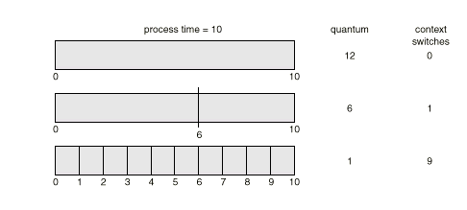
How a Smaller Time Quantum Increases Context Switches

Slide 26
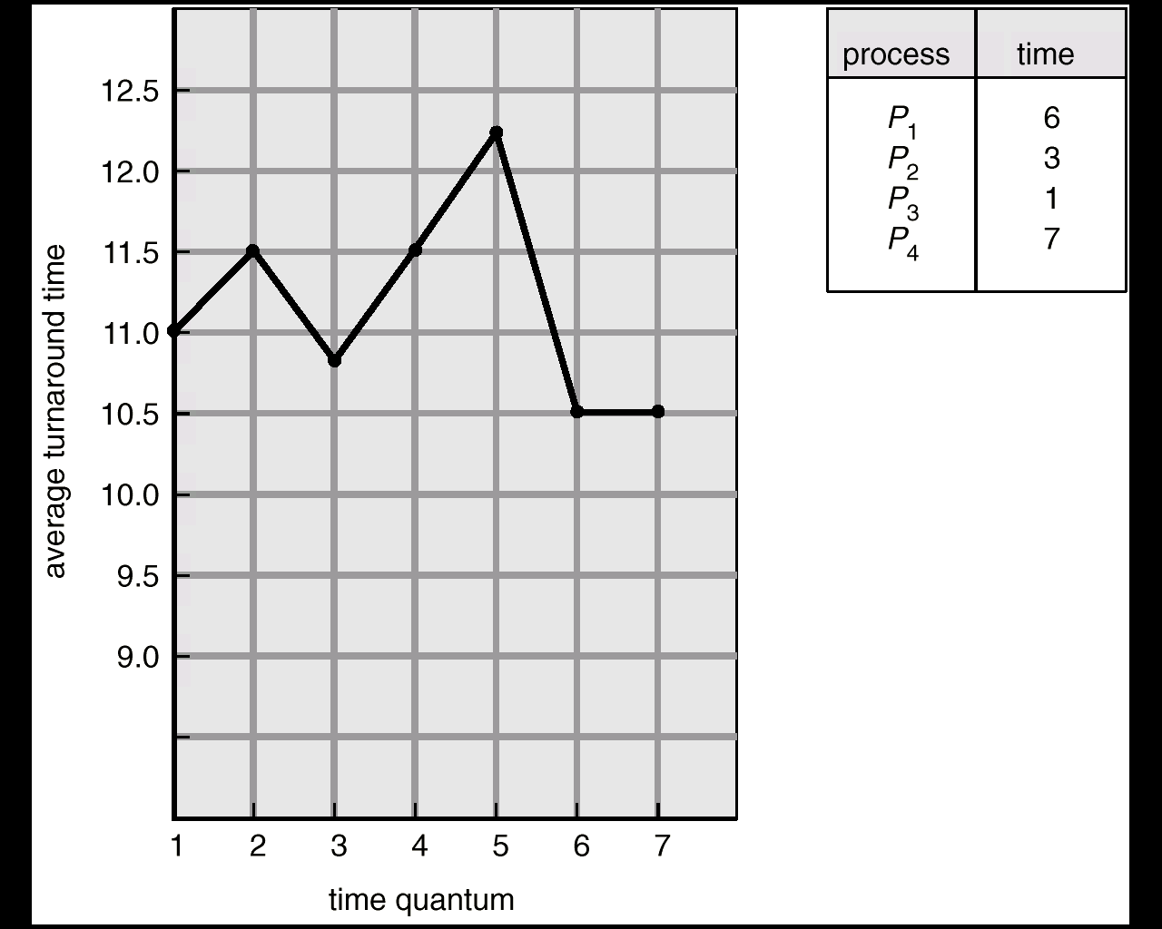
Turnaround Time Varies With The Time Quantum

Slide 27
Multilevel Queue
Ready queue is partitioned into separate queues:
foreground (interactive)
background (batch)
Each queue has its own scheduling algorithm,
foreground – RR
background – FCFS
Scheduling must be done between the queues.
  Fixed priority scheduling; i.e., serve all from foreground then from background. Possibility of starvation.
  Time slice – each queue gets a certain amount of CPU time which it can schedule amongst its processes; i.e.,
  80% to foreground in RR
  20% to background in FCFS

Slide 28
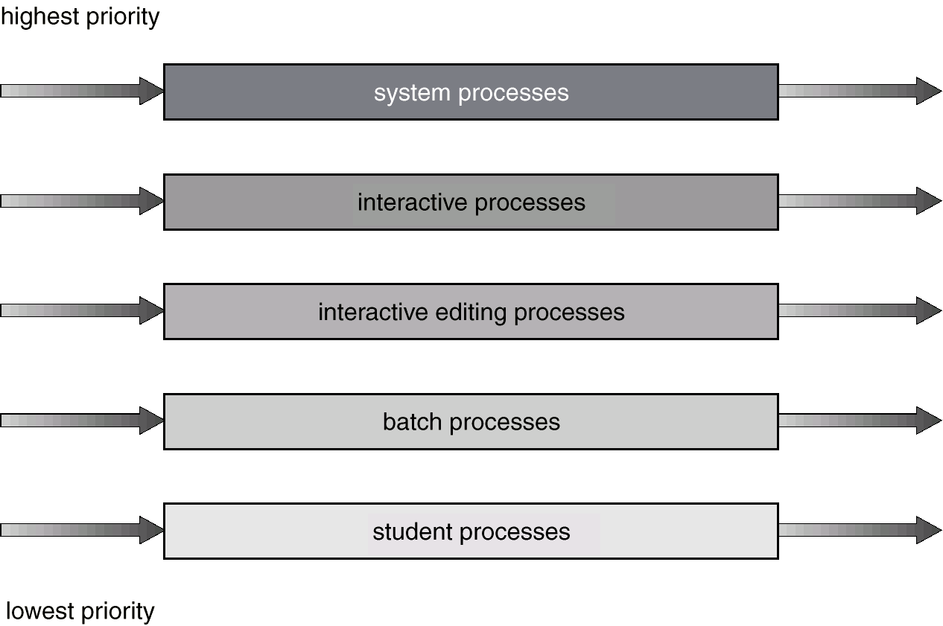
Multilevel Queue Scheduling

Slide 29
Multilevel Feedback Queue
A process can move between the various queues; aging can be implemented this way.
Multilevel-feedback-queue scheduler defined by the following parameters:
  number of queues
  scheduling algorithms for each queue
  method used to determine when to upgrade a process
  method used to determine when to demote a process
  method used to determine which queue a process will enter when that process needs service

Slide 30
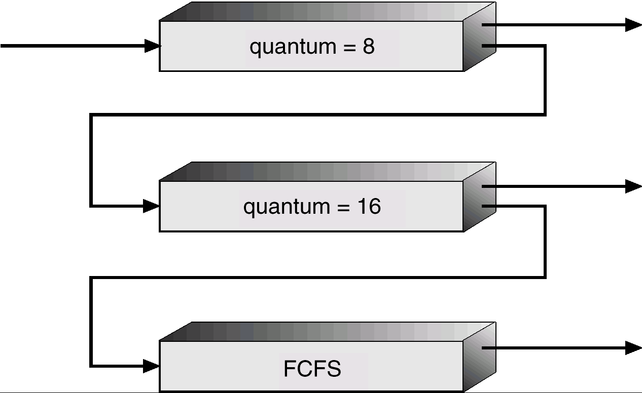
Multilevel Feedback Queues

Slide 31
Example of Multilevel Feedback Queue
Three queues:
  Q₀ – time quantum 8 milliseconds
  Q₁ – time quantum 16 milliseconds
  Q₂ – FCFS
Scheduling
  A new job enters queue Q₀ which is served FCFS. When it gains CPU, job receives 8 milliseconds. If it does not finish in 8 milliseconds, job is moved to queue Q₁.
  At Q₁ job is again served FCFS and receives 16 additional milliseconds. If it still does not complete, it is preempted and moved to queue Q₂.

Slide 32
Multiple-Processor Scheduling
CPU scheduling more complex when multiple CPUs are available.
Homogeneous processors within a multiprocessor.
Load sharing
Asymmetric multiprocessing – only one processor accesses the system data structures, alleviating the need for data sharing.

Slide 33
Real-Time Scheduling
Hard real-time systems – required to complete a critical task within a guaranteed amount of time.
Soft real-time computing – requires that critical processes receive priority over less fortunate ones.

Slide 34
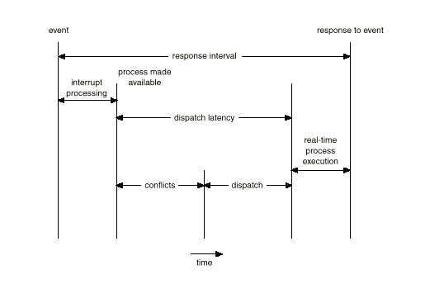
Dispatch Latency

Slide 35
Algorithm Evaluation
Deterministic modeling – takes a particular predetermined workload and defines the performance of each algorithm for that workload.
Queuing models
Implementation

Slide 36
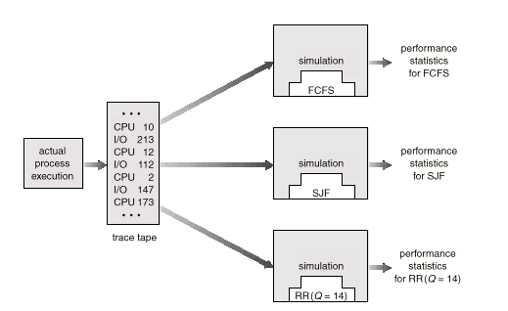
Evaluation of CPU Schedulers by Simulation

